Slide 1

Applying Topic Modeling to Terrorist Organizations Portrayal in Traditional Media Outlets
GROUP 7
Nikhita Peddi 2215340
Mukesh Reddy Mavurapu 2251153
Shiva Sai Ram Prasad Reddy Yelipeddi 2250576
Presentation Date : 11/21/23

Slide 2
Problem Statement and Motivation
Problem Statement: Traditional media's portrayal of terrorist organizations poses challenges for public perception, policy formulation, and national security due to the vast and complex textual data generated. Analyzing news articles, reports, and editorials requires advanced text mining, particularly topic modeling, to identify prevalent themes and biases effectively.
Motivation: The urgent need to understand the nuanced narratives and trends within media representations of terrorist organizations drives our motivation. Applying topic modeling will provide insights that contribute to informed counter-terrorism strategies and foster a more nuanced public discourse on this critical issue.

Slide 3

Data Preprocessing Methods
Data cleaning which includes cleaning each article, and removing unwanted documents without any content
Removing metadata
Tokenizing the articles
Removing stop words
Stemming
Calculating word frequency

Slide 4
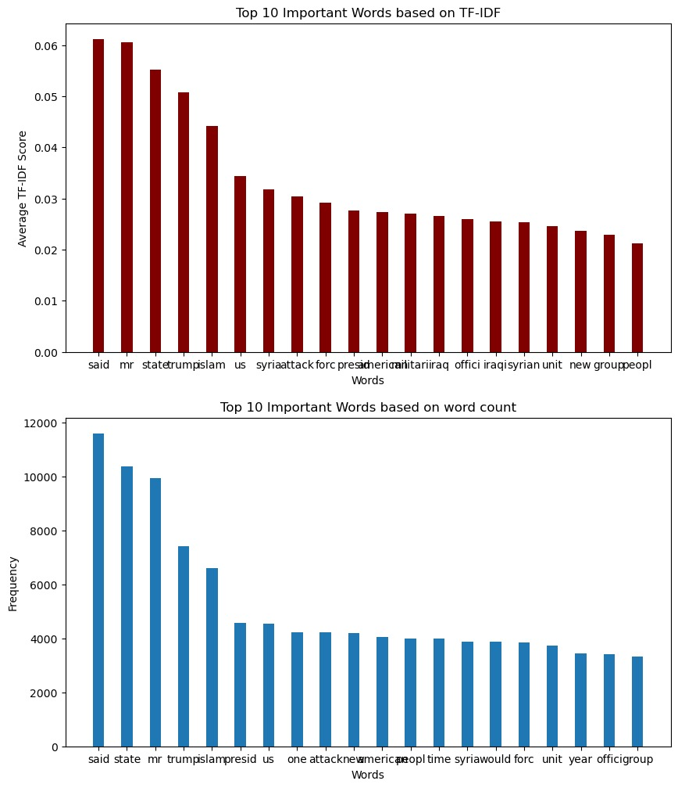
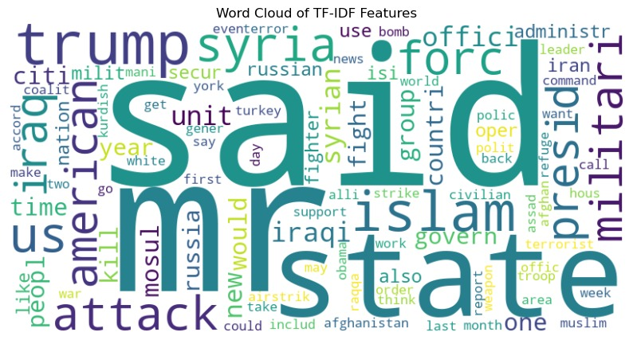
Exploratory data analysis
Feature Extraction
Feature extraction summary
Exploration Plots

Slide 5
Topic Modelling Techniques
Latent Dirichlet Allocation (LDA) is a probabilistic model commonly used in natural language processing and machine learning.
It is designed to discover topics within a collection of documents.
LDA assumes that each document is a mixture of a small number of topics and that each word in the document is attributable to one of the document's topics.
Through statistical inference, LDA identifies these underlying topics and their distribution across the documents, providing a valuable tool for topic modeling and document clustering.

Slide 6
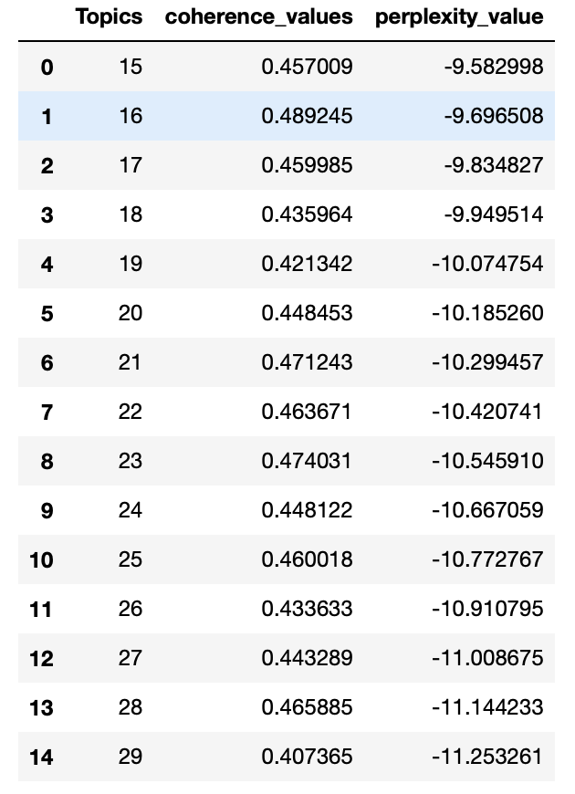
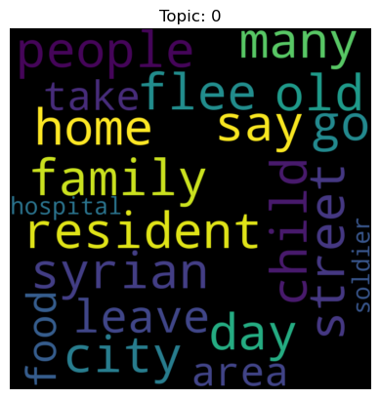
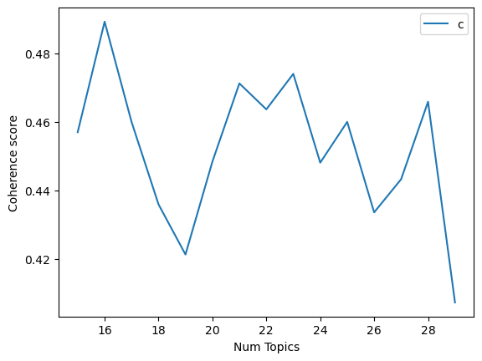
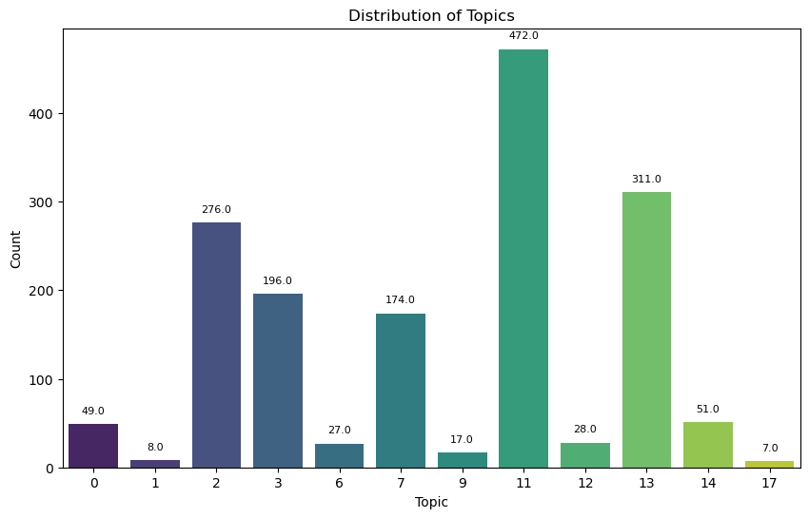
Results, Findings and Implications
By evaluating, we get Perplexity : -10.18 and Coherence score : 0.448
The results are as follows:

Slide 7
Conclusions and Implications
This project underscores the pivotal role of initial data processing and exploratory analysis in evaluating newspaper content through topic modeling.
By refining a corpus and identifying key features, we generated concise summaries and visual aids, providing deeper insights for journalists.
The findings emphasize the importance of meticulous data preparation in journalism, ultimately empowering storytellers with impactful narratives.
Future research could explore excluding common words and employing novel analytic methods or applying this methodology to diverse datasets for comparative analysis.

Slide 8
Discussion of challenges and lessons learned
Challenges:
Data cleaning
LDA optimal topics selection
Lessons Learned:
Importance of Rigorous Data Cleaning
Standardized Preprocessing
Fine-tuning Model Parameters
Domain Knowledge Integration

Slide 9
Future work or recommendations
Refinement of Analysis Techniques
Optimizing Data Preprocessing
Incorporating Multimodal Data
Cross-Domain Application
Collaboration with Journalists
Continuous Exploration of Language Patterns

Slide 10
THANK YOU !!!

